Slide 1
SAMS and Micro-data: New Areas of Research
Paul Schreyer OECD
IIOA
Towards New Horizons of
Innovation, Environment and
Trade
Kitakyushu July 2013

Slide 2
Overview
Measuring well-being and living standards - policy demand
Distributional information and the national accounts – bridging the gap
SAM as a tool to structure and analyse data
From SAMs to living standards

Slide 3
1. Measuring well-being and living standards - policy demand

Slide 4
Increasing recognition that…
While GDP is a key measure to monitor macro- economic activity, productivity, demand for paid-jobs
GDP is not a metric for people’s well-being and is often at variance with people’s personal experiences
Measuring well-being implies confronting values: from “treasuring what you measure” to “measuring what you treasure”
Notes:
4

Slide 5

Many activities
UNDP Human Development Reports
OECD Fora since 2003
Stiglitz-Sen-Fitoussi Commission (2009)
EU: GDP and Beyond
And significant interest at national and local level
OECD How’s Life?

Slide 6
Dimensions – OECD Framework

Slide 7
Measuring Well-being requires looking at:
  Households and people
  Outcomes, not inputs or outputs
  Assessing inequalities alongside averages
Notes:
7

Slide 8
So where do SAM and micro-data come in?
  Apply criteria to measuring material well-being and living standards:
  Households and people → institutional sectors
  Outcomes → HH income and its components
  Inequalities → HH distributional information
  This is exactly what SAMs have been conceived for
Notes:
8

Slide 9
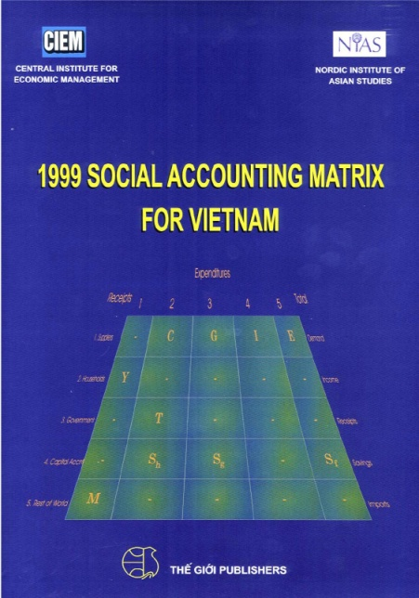
A little reminder on SAMS
Richard Stone 1960s; Pyatt, Thorbecke 1970s
Keunig (1994)
Eurostat Handbook 2003
Use for development planning (Pyatt and Round 1977),
Concept: consistent integration of:
  SUTs or IOT
  institutional sector accounts
  socio-economic break-down of households or labour
  national accounts matrix with expanded information on households or labour

Slide 10
National Accounts Matrix

Slide 11
SAM

Slide 12

For purpose at hand, SAMs are useful to:
Systematise link between:
  Primary income types:
    Wages and salaries
    Mixed income
    Gross operating surplus
    Other net taxes on production
  Disposable income inequality = HHs grouped by quintiles, deciles, etc.
Where does disposable income for a particular HH originate?

Slide 13

But there is a major statistical issue:
NA aggregates and HH survey data on (income) distribution are inconsistent

Slide 14
2. Distributional information and the national accounts – bridging the gap

Slide 15


Survey information and national accounts
Distributional information: bottom-up <- household surveys
Average and macro information: top-down <- national accounts
Conceptual differences:
  Scope
  Units (individuals vs households)
  Definition of income
    Imputations: OOH, FISIM
Empirical differences:
  Property income (e.g., interest received)
  Mixed income (self-employed)

Slide 16
OECD-Eurostat Expert Group
  To examine differences NA – Surveys
  To develop NA-compatible distributional data
  Income, consumption and savings for 16 countries
Results forthcoming (Fesseau et al 2013)

Slide 17
Do NA-Survey differences matter? Yes.
Adjustment coefficient for income components (NA/Survey ratio)

Slide 18
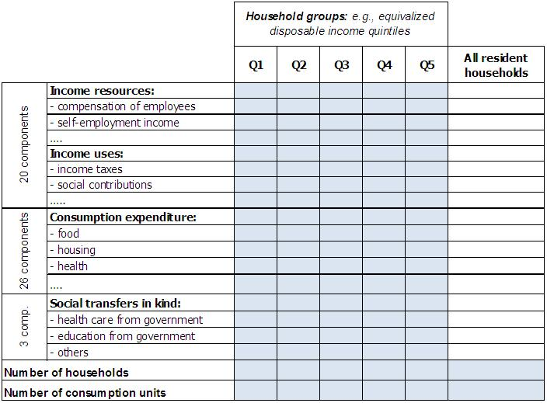
Data needed by groups of HHs

Slide 19
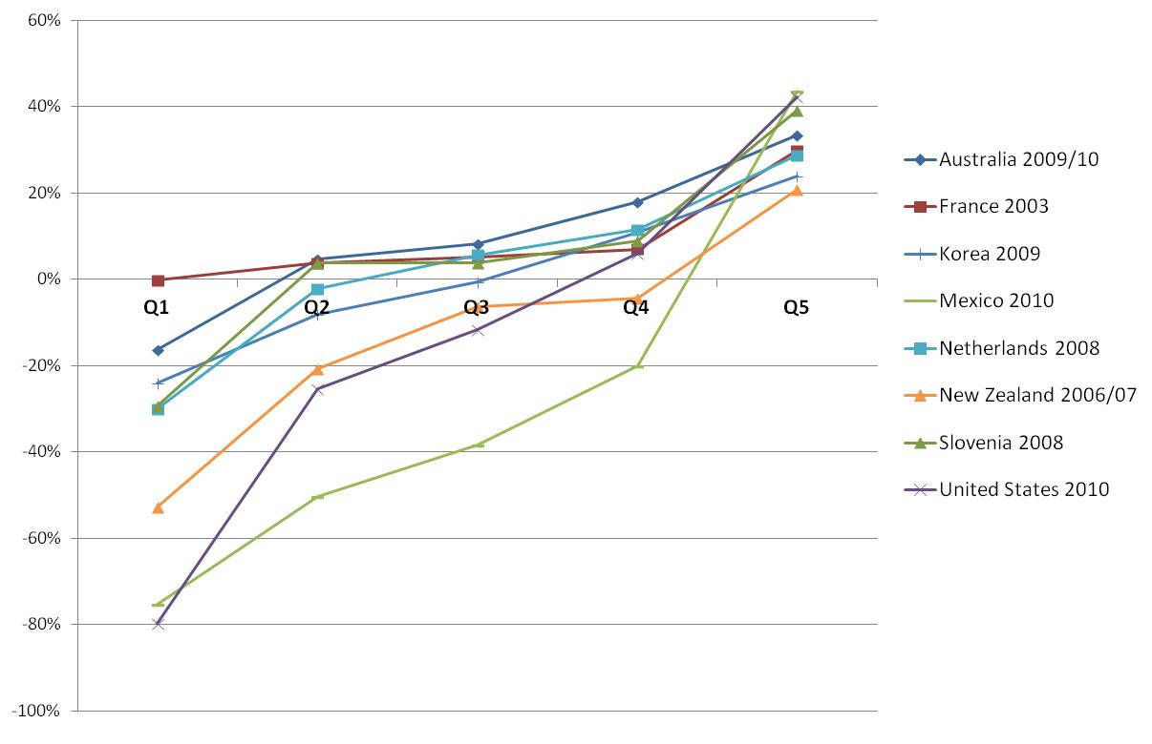
Example of disparity indicator: savings
Savings* as a percentage of adjusted disposable income, by income quintile
Notes:
* Difference between adjusted disposable income and actual final consumption plus the change in net equity of households in pension funds.

Slide 20
3. Back to the SAMS:
A tool to structure and analyse data

Slide 21
New multipliers
SAM flows for HH by type of HH
But also: multipliers
  Given a certain value-added generated in industries, what are the direct and indirect effects on HHs disposable income?
Compare with traditional I/O multipliers:
  Given a certain final demand, what are the direct and indirect effects on industries production and value-added?

Slide 22
Example: Portugese SAM (Reich 2012)
For OECD work on well-being, classification by income group would be preferable
No redistributional effect?
Missing: STIK
Notes:
63.9 % of wage income by a primary-educated male goes to households living mainly on wages and salaries
10.6 % of wage income by a primary-educated male goes to households living mainly on pensions

Slide 23

To be developed…
Typical SAM does not cater for Social Transfers in Kind (STIK)
Introduce adjusted disposable income and actual individual consumption
Otherwise, measure of living standards incomplete

Slide 24
Relative position of the 20% richest households to the 20% poorest households

Slide 25
From SAMs to measurement of living standards

Slide 26
Aggregate measures of material well-being (welfare economics)
Large body of literature
Recent empirical studies
  Jorgenson and Slesnick (2013)
  Fleurbaey and Gaulier (2009)
  Jones and Klenow (2011)
  Fleurbaey and Blanchard (2012)
(But not typically based on SAMs or on adjusted disposable income)

Slide 27
Basic Idea
Averages
Distribution

Slide 28
Jorgenson and Slesnick (2013) Measuring Social Welfare in the US National Accounts

Slide 29
Construction of index of living standards/material well-being
Requires consistent information on HHs
Micro – NA consistency would improve results in the literature that do not address this issue
Best: structured in SAM

Slide 30
Summing up
Increasing interest in measurement and analysis of well-being and living standards
Requires:
  consistent data on HH accounts, from primary to disposable income
  Break down by socio-economic characteristics
SAM is excellent accounting framework
Few SAMs exist but clear policy demand may change this

Slide 31
Summing up (2)
Needed: bridge NA and micro survey data
Also needed: consistency between micro data on consumption, income, wealth

Slide 32


Commercial break for recent OECD methodological publications
OECD guidance on the measurement of:
Micro Statistics on Household Wealth
www.oecd.org/statistics/guidelines-for-micro-statistics-on-household-wealth.htm
the Distribution of Household Income, Consumption and Wealth
www.oecd.org/statistics/ICW-Framework.htm

Slide 33
Summing up (2)
Looking ahead:
  Microdata for STIKs
  Microdata for bringing in non-market production and consumption
  From (adjusted) disposable to full income
For analysis, use SAM multipliers and plug into literature on welfare measurement
There’s much work to be done!

Slide 34
Thank you!
Paul.Schreyer@oecd.org

